Slide 1

Department of Electrical and Electronics Engineering
(Established - 2001)
Accredited by NAAC with ‘A’ Grade, Accredited by NBA
One of the prestigious branches of Engineering and one among the oldest Departments of NHCE

Slide 2
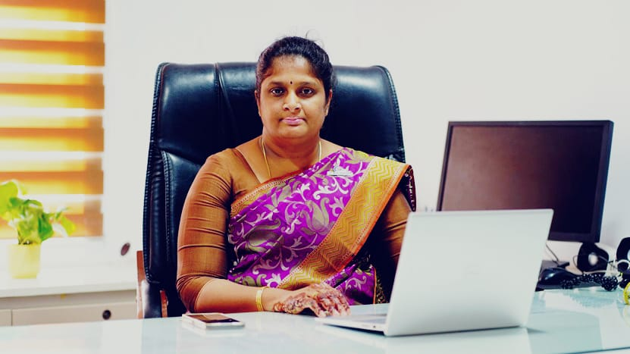
HEAD OF THE DEPARTMENT
B.E- EEE
Dr. S.Sujitha B.E, M.E , PhD
PhD (Electrical Engineering) M.E (Applied Electronics)
B.E (Electrical and Electronics Engineering)
Area of Research: Digital, Embedded Systems, EV Automation, Artificial Intelligence, Data Analytics, VLSI, Renewable Energy, Smart Grids and Soft Computing.
Publication: More than 50 papers in International, National journals and Book Chapter Publications
Patents: Published 25 Patents and received one Design Grant in LUMBAR SUPPORT QUAD BIKE for 15 Years.
Ph.D. Guidance: Recognized Research Supervisor in Vishweshwaraya Technological University(VTU ) , Karnataka and Guiding PhD Research Scholars Under
Achievements:
Professional Member in ISTE, IEEE, IAENG and Student branch Advisor for IEEE Dielectrics and Electrical Insulation Society
Received 18 Grants from various Govt Funding Agencies such as AICTE AQIS, VGST, KSCST, VTU Grants etc.
Editorial board member for three international Journals, BOS/BoE Member in Various Autonomous Engineering Colleges.
Received “OUTSTANDING YOUNG ENGINEER AWARD” and “BEST PERFORMING PROFESSOR” award by ITCA & Committee for Space Programme Development, SERBIA.
Received “Certificate of Award” by UNITYsat Team for the Successful Design and Development of UNITYsat from SDSC-SHAR, Sriharihota by UNISEC INDIA.

Slide 3
PROGRAMS OFFERED
B.E- EEE
B.E – Electrical and Electronics Engineering
COURSE STRUCTURE – (Curriculum Design as per Industry Expectations)
Basic Science Courses​
Engineering Science Courses​
Humanity Social Science & Management Courses​
Professional Core Courses​
Professional Elective Courses​
Open Elective(multidisciplinary) Course​s
Ability Enhancement Courses​
Skill Courses (Mini Projects and Major Project)​
Skill Courses (Internship)​
Skill Course(Seminar)​
Industry Institute Interaction Courses
Mandatory courses UGC/AICTE/UHV​

Slide 4
PROPOSED COURSE WISE CREDIT DISTRIBUTION
B.E- EEE
Sl. No | Course category | Courses Semester-wise |  |  |  |  |  |  |  | Total Subject | Credits course category wise
 |  | I | II | III | IV | V | VI | VII | VIII
1 | Applied Science Courses | 6 | 6 | 3 | 3 |  |  |  |  | 6 | 18
2 | Applied Science Course Lab | 2 | 2 |  |  |  |  |  |  | 4 | 04
3 | Engineering Science Courses | 3 | 5 |  |  | 3 | 3 |  |  | 5 | 14
4 | Engineering Science Course Lab |  | 1 |  |  |  |  |  |  | 1 | 01
5 | Programming Language Courses | 3 |  |  |  |  |  |  |  | 1 | 03
6 | Emerging Technology Courses | 3 | 3 |  |  |  |  |  |  | 2 | 06
7 | Ability Enhancement Courses | 2 | 2 | 1 | 1 | 4 | 2 |  |  | 7 | 12
8 | Humanity Social Science & Management Courses | 1 | 1 |  |  | 3 |  |  |  | 3 | 05
9 | Professional Core Courses |  |  | 12 | 9 | 6 | 6 | 6 |  | 13 | 39
10 | Professional Core Courses Lab |  |  | 2 | 3 | 2 | 2 | 2 |  | 5 | 11
11 | Professional Elective Courses |  |  |  | 3 |  | 3 | 3 | 6 | 5 | 15
12 | Open Elective(multidisciplinary) Course |  |  |  |  |  | 3 | 3 |  | 2 | 06
13 | Skill Courses (Mini Project)(Full Project) |  |  |  | 1 | 1 | 2 | 10 |  | 4 | 14
14 | Skill Courses (Internship) |  |  |  |  |  |  |  | 10 | 1 | 10
15 | Mandatory courses UGC/AICTE/UHV |  |  | 1 | 1 |  |  |  |  | 2 | 02
Total credits semester wise |  | 20 | 20 | 19 | 21 | 19 | 21 | 23 | 17 |  | 160

Slide 5
CURRICULUM BREAKUP
B.E- EEE
Course Category | Credits | Percentage
Applied Science Courses | 22 | 14%
ESC/PLC/ETC | 24 | 15%
Ability Enhancement Courses | 12 | 8%
Humanity Social Science & Management Courses | 5 | 3%
Professional Core Courses | 50 | 32%
Professional Elective Courses | 15 | 9%
Open Elective(multidisciplinary) Course | 6 | 4%
Skill Courses (Mini Project)(Full Project) | 24 | 15%
Mandatory courses UGC/AICTE/UHV | 2 | 1%

Slide 6
STRENGTHS OF THE DEPARTMENT
B.E- EEE
State of Art-Facilities
Co-Curricular Activities
Highly qualified and dedicated faculty
Experienced lab Instructors
Industry sponsored labs
BE Honors degree/Minor Degree
Smart Ubiquitous class rooms
State of the art laboratories
Exclusive Research laboratory
Professional skill development courses (by industry experts)
MOOC Courses like NPTEL, Coursera, Saylor, EdX, IIT Bombay spoken Tutorial etc
Hands-On Workshops/Trainings
Focus on Industry Internships
Industry Expert Lectures
Alumni Lecture Series, Seminars, , Tedx Talks
Industrial Visits
Indo-French Centre of Excellence in Electricity, Automation and Energy (IFCEEAE) - “MoU” with French Ministry of National Education and Schneider Electric India Pvt. Ltd.
STUDENT EXCHANGE PROGRAMS in France Universities through MoU

Slide 7
BEST PRACTICES IN EEE
B.E- EEE
Provide Suitable Forums (TLP)
Tedx Talks/ Industry Expert Lecture,
Assessment
Open Book Test
Review of Literature
Enhance the Research and Development
Fostering research culture through virtual community learning towards academic development
International conference/Funded Seminars
Awareness Talk/ Alumini Talk
Value added core courses
Industrial Visits/Internship/Study Abroad
programmatic research
Internationalizing Teaching and Learning through Faculty Inquiry Circles (Coursera, NPTEL, Edx, OBE, case studies-IEEE, IEA,IEC Stds etc)
Virtual Labs Integration - https://plc-coep.vlabs.ac.in/List%20of%20experiments.html
Generative AI Tool –(Chat GPT in TLP)
IBM Academic Initiative Badges
Inculcating the awareness
Responsibility towards Environment
Energy Conservation & Sustainable Projects
Ethical values
AICTE Activity Points
Yoga
NPTEL/Mooc etc
Industry – Academia Interaction
Digital Safety & AI Ethics Awareness
Hons /Minor Degree
Cleanliness Drive
EV – Air Pollution
Health and Mental wellness
Professional Ethics & Engineering Responsibility-IKS
Safety measures in road
Entrepreneurial Development
Orphanage Visit
Sports
NSS/NCC/Yoga
IIT Bombay spoken Tutorial /WHO
Publication, patent, grant, Govt funded projects, consultancy, MoU etc
Hackathons
Startup Incubation & innovation
Innovative Teaching–Learning Practice (TLP)
Project Based Assessment
Green Campus initiatives
Mentoring/Career Guidance

Slide 8
Innovative Student Centric Activities in Teaching and Learning
B.E- EEE
Mind Mapping Approach-Transmission & Distribution
Simulation Approach-Photo Voltaic Systems & Applications
Flipped Classroom-Power System Analysis
Discussion Approach-Power System Protection
Experiential Learning-–Power System Analysis
Case Based Learning--Synchronous and Induction Machines
Experiential Learning - Power Electronics
Simulation Approach- -Microcontroller & Embedded Systems
Experiential Learning –Power System Analysis
Team Based Co-operative Learning--Microcontroller and Embedded Systems
Mind Mapping--Synchronous and Induction Machines
Simulation Approach-Control Systems
Team based Co-operative Learning-Power System Protection
Simulation Approach- Power Electronics

Slide 9
Innovative Student Centric Activities in Teaching and Learning
B.E- EEE
Experiential based Learning approach
Experiential learning approach-Introduction to Electrical Engineering
Experiential Learning Approach--Relay & High Voltage
Flipped Classes
Team based/cooperative learning-Introduction to Electrical Engineering
Project Based Learning
Simulation Approach-Electric Circuit Theory
Experiential learning
Problem Solving Approach
Mind Mapping Activity
Team Based Learning Approach-
Experiential learning approach

Slide 10
STRENGTHS OF THE DEPARTMENT
B.E- EEE
Beyond Curriculum
Professional society Chapters- IEEE- PELS , IEEE- IES, IEEE-DEIS, IEEE-PES, IEEE-TEC
Entrepreneurship and Innovation Programs
Study abroad programs
Foreign Language Training
Technical writing and presentation skills
Leadership and communication training
Student cocurricular clubs – Green Energy club
Industry Institute Interaction -MoU
Research Publications in Scopus/WoS /SCI Journals
Patent filing/Publications
Industry Consultancy

Slide 11

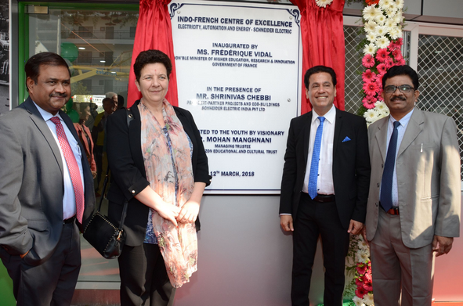
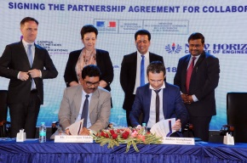



CENTRE OF EXCELLENCE AND MOUs
B.E- EEE
Indo-French Centre of Excellence in Electricity, Automation and Energy(IFCEEAE)
MoU focuses on Projects in Automation, Electric Vehicles, Internship and Placement

Slide 12
B.E- EEE
Center of Excellence
Industry Aligned Courses Offered | Type
Advanced Industrial Automation and Building Automation | Professional elective/Core
Industrial Automation | Open Elective
Designed & delivered in collaboration with Schneider Electric
Unique and Promotional Activities
Automation based Mini and Major Projects on PLC, SCADA, Smart Buildings, EMS, Automation
Two week Internship for students – Hands on Exposure to real industrial automation systems
Motivating students for Study abroad Programs
Proposed SCADA Course in Schneider lab
Industry-grade software & controllers
Train the Trainers in Endless Automation
Career Outcomes: Automation Engineer | PLC Programmer | SCADA Engineer | Smart Building Engineer | Energy Automation Specialist

Slide 13
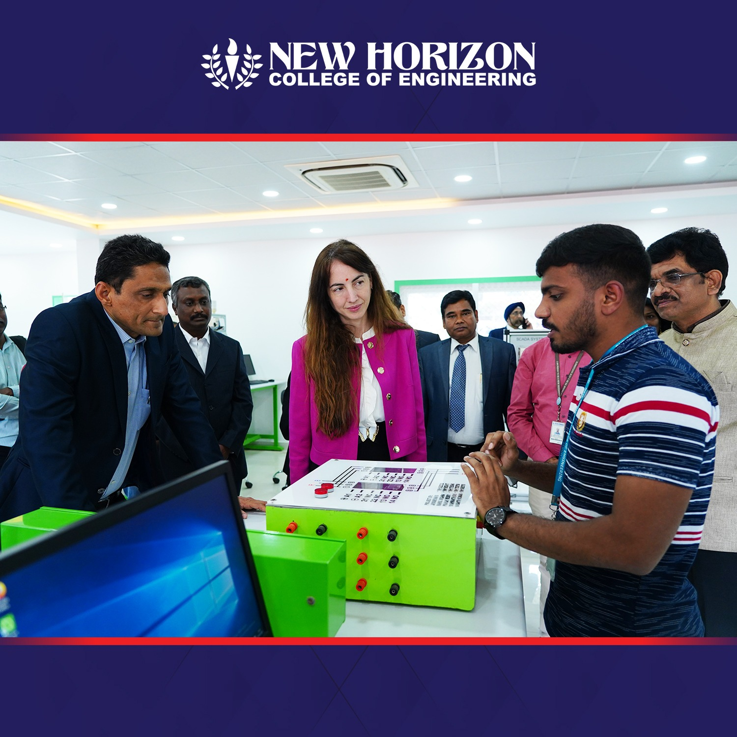
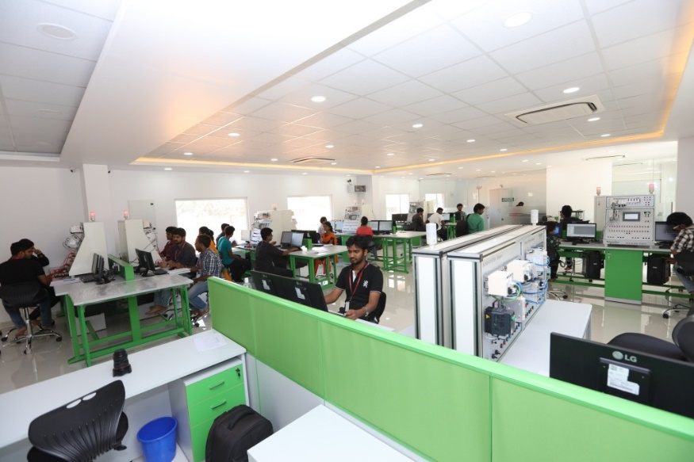
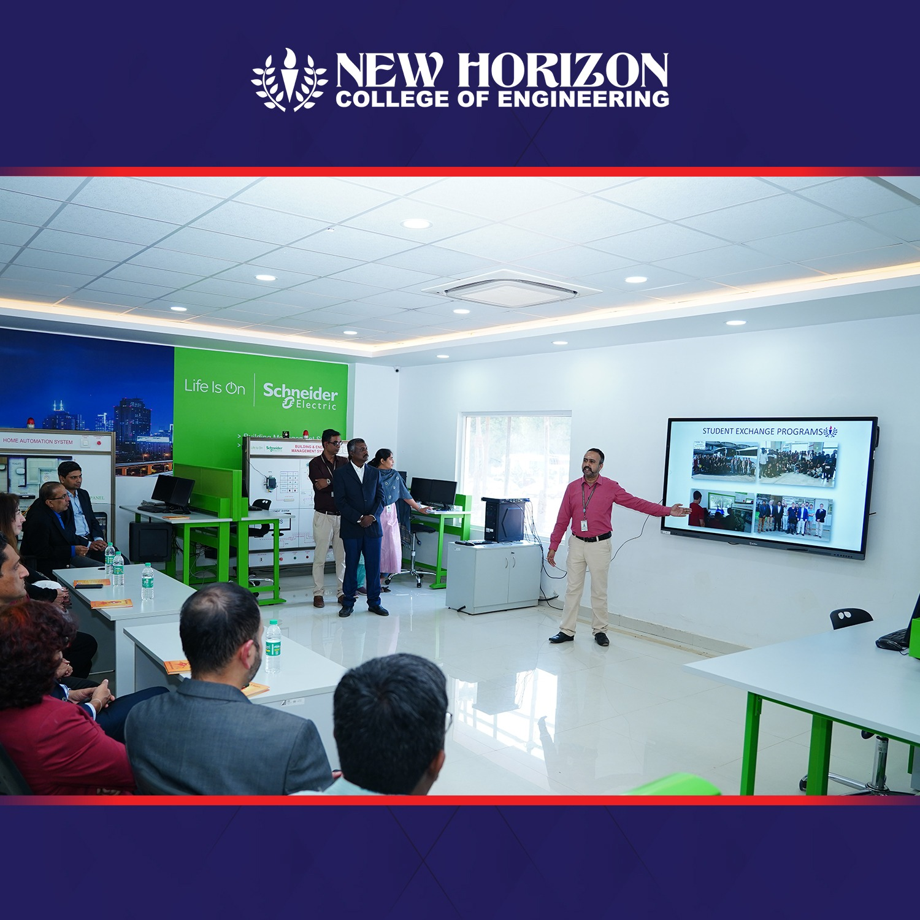
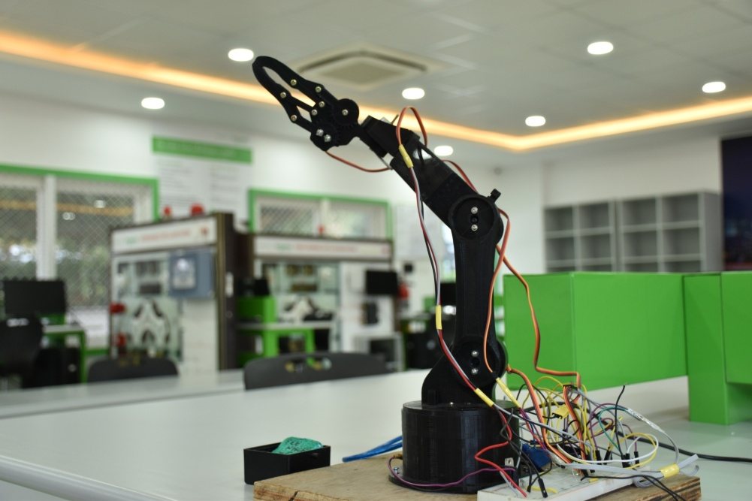
INDUSTRY SPONSORED LABORATORY
B.E- EEE
Indo-French Centre of Excellence in Electricity, Automation and Energy(IFCEEAE)

Slide 14
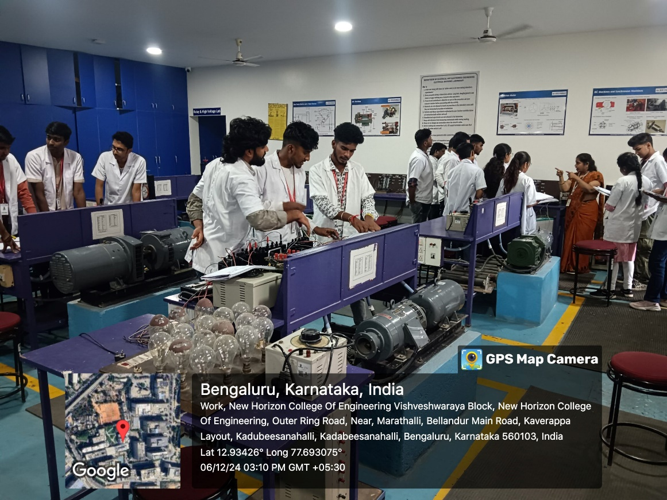
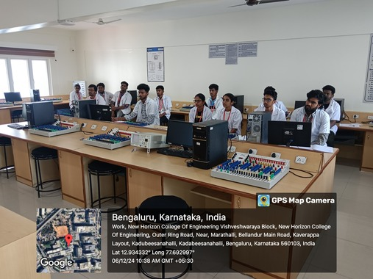
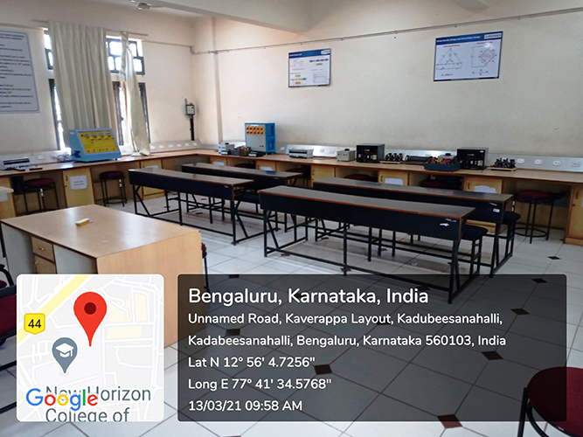
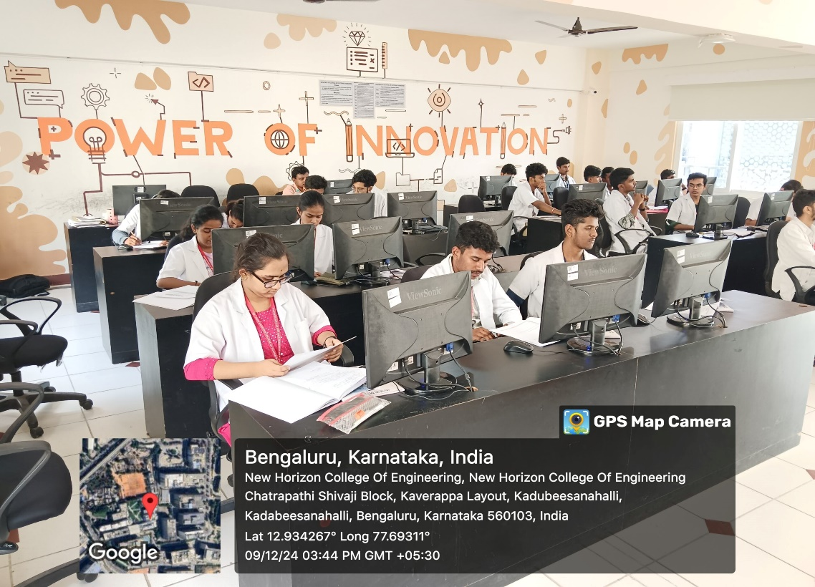
DEPARTMENT LABORATORIES
B.E- EEE
Electrical Machines Lab-I &II
Analog Electronics and Microcontroller Lab
Control and Measurement Lab
Power system & Simulation Lab

Slide 15
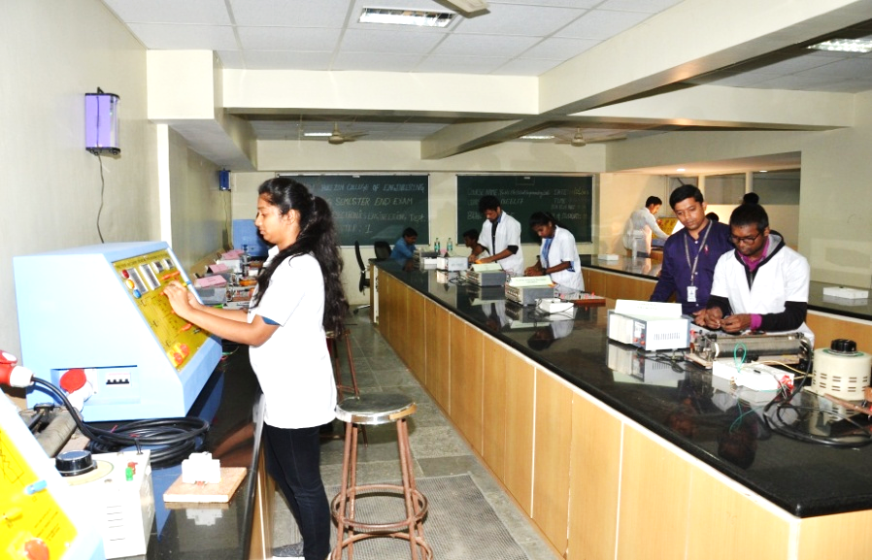
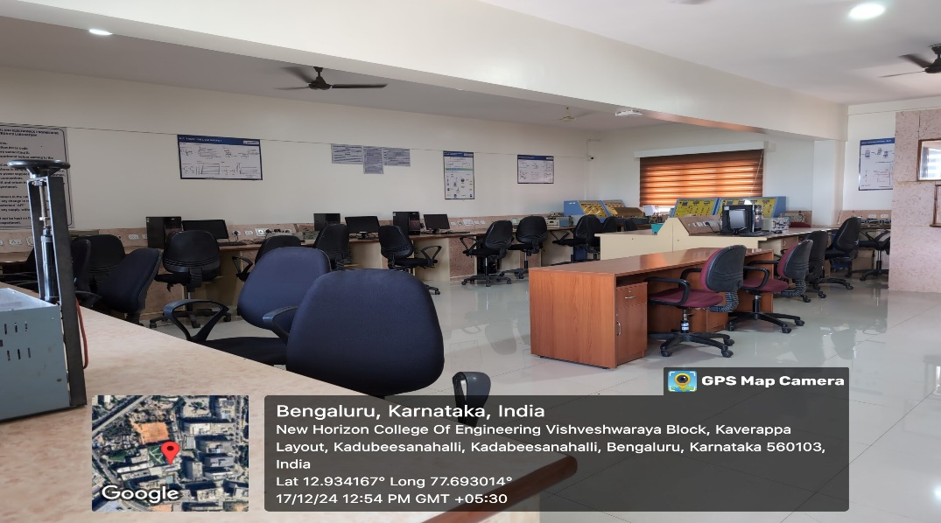
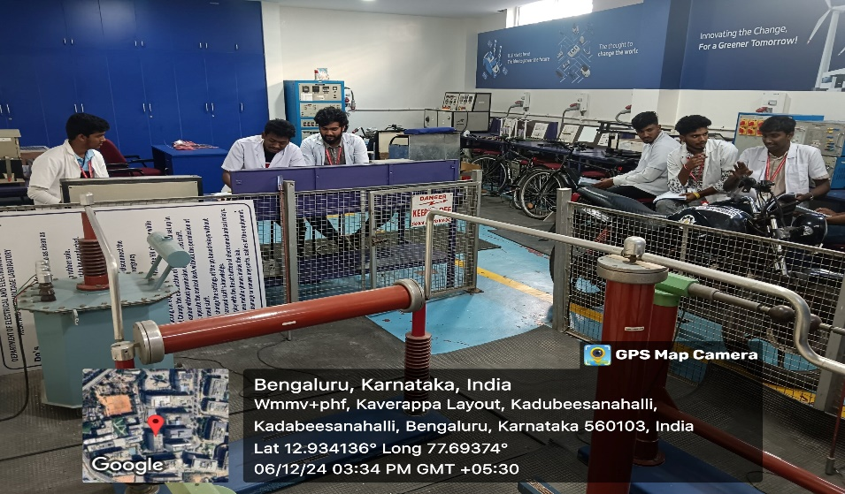
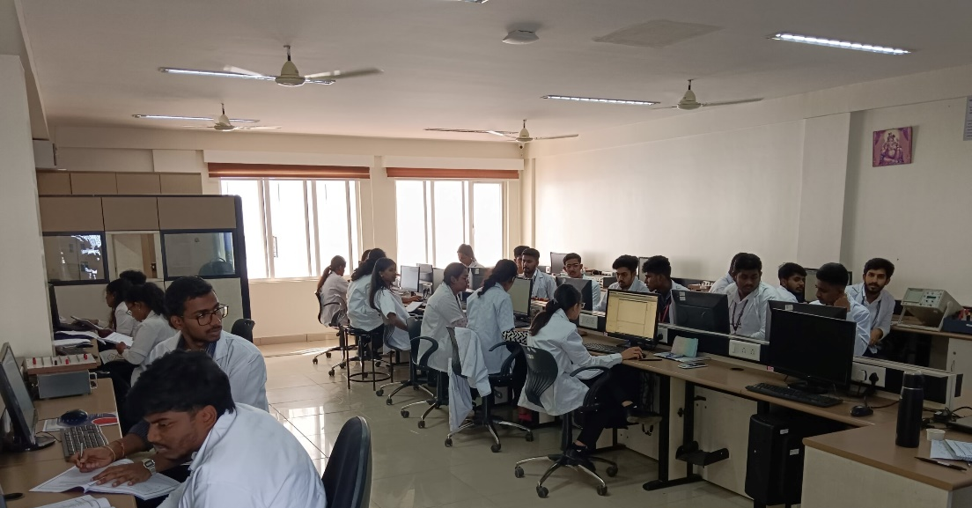
DEPARTMENT LABORATORIES
B.E- EEE
Electrical Research Laboratory
Digital & Power Electronics Lab
Relay and High voltage Laboratory
Electric Circuit and Simulation Lab

Slide 16
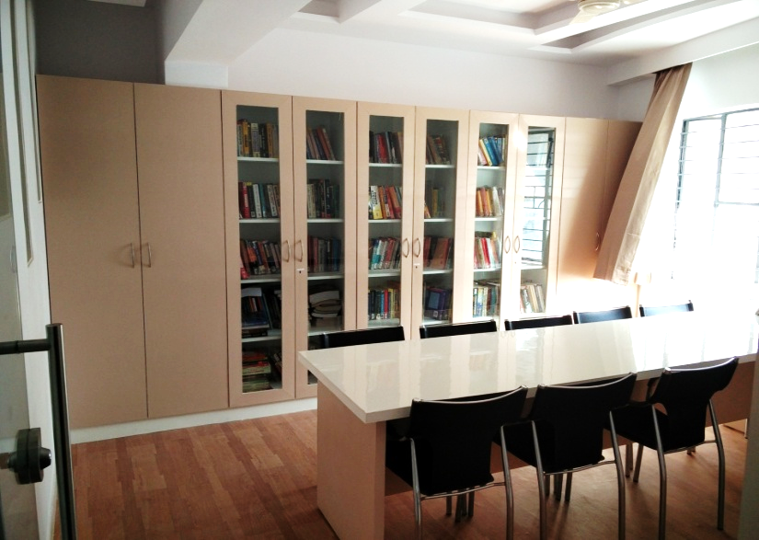
B.E- EEE
.
Department
Library

Slide 17



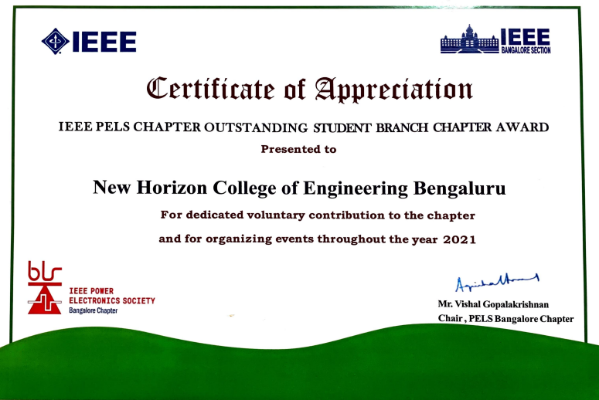



IEEE PROFESSIONAL SOCIETY CHAPTERS

Slide 18
DEPARTMENT ACHIEVEMENTS / RECOGNITIONS
B.E- EEE
Sponsored Research
Sponsored Research Projects
More Funded Projects from Government and Non Government funding agencies
Publications Details
Faculties and Students have published more than 160 papers in refereed journals
Patents Filled
Faculties and Students have published more than 85 Patents
Department have 100% of Enrollment ratio for 3 assessment year
Placement
Enrollment Ratio
Department have achieved 91% Placement for the academic year 2024-25
Students Club
Students cocurricular club -Green Energy Club
Professional Society
Professional Societies like IEEE PELS and IEEE-IES Student Branch Chapter
Industry Sponsored Lab
Schneider Electric - Indo-French Centre of Excellence in Electricity, Automation and Energy(IFCEEAE)
Rs. 13,38,162 /- MODROB of HV Lab by AICTE
Rs. 5,00,000/- Research Project by VGST
Rs. 93,000/- FDP Grant by AICTE AQIS
Rs. 10,00,000/- Conference Grant - AICTE
Rs. 2,50,000/- FDP Grant by AICTE AQIS
Rs. 1,40,000/- Research Project –KSCST SPP
Rs. 7,48,333/- STTP Grant – AICTE
Rs. 4,50,000/- Chapter Activity Fund -IEEE
Rs. 10,000/- Research Grant -VTU
Rs. 15,00,000/-Research Project- ITC
3,50,000/ - ATAL FDP - AICTE
Rs. 3,00,000/- Seminar Grant - ANRF

Slide 19
RESEARCH AND DEVELOPMENT
B.E- EEE
Academic Research Publications
AY | Journals | Conferences | Book Chapters | Total
2024-25 | 16 | 43 | 6 | 65
2023-24 | 16 | 8 | 5 | 39
2022-23 | 20 | 30 | 4 | 54
2021-22 | 19 | 25 | 5 | 49
2020-21 | 7 | 14 | - | 21
2019-20 | 12 | 8 | - | 20
2018-19 | 13 | - | - | 13
VTU Recognized Research Supervisors
S. No. | Research Supervisor | Qualification | Area of Specialization
1 | Dr. Sujitha S | Ph.D | Electrical Engineering
2 | Dr. Agalya V | Ph.D | Electrical Engineering
3 | Dr. Gunapriya B | Ph.D | Power Electronics and Drives
4 | Dr. Vinoth Kumar K | Ph.D | Power Electronics and Drives
5 | Dr. Mohandas R | Ph.D | Power Electronics and Fuzzy Logic
6 | Dr. Karthika M | Ph.D | Power Electronics and Drives

Slide 20
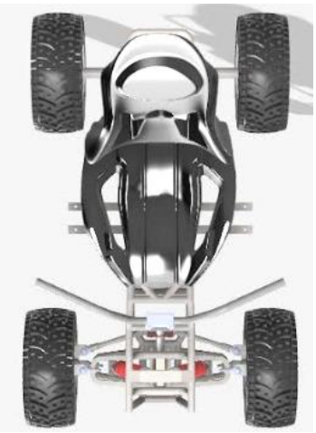
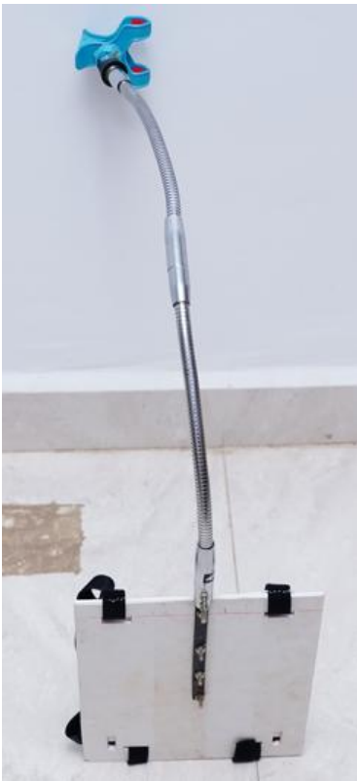
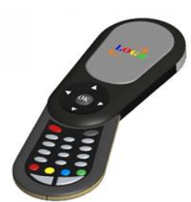
B.E- EEE
PRODUCT DEVELOPMENT – PATENT DESIGN
Lumbar Support Quad Bike
Rear Camera Fixture for Military Purpose
Adjustable Antifall Multipurpose Table
A foldable television remote

Slide 21
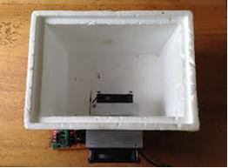
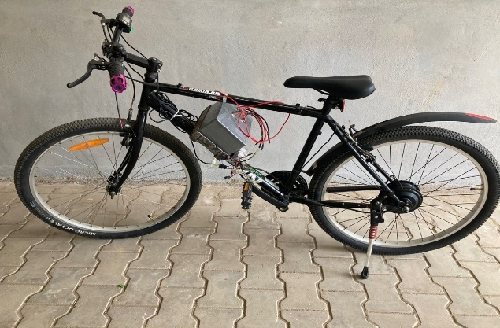
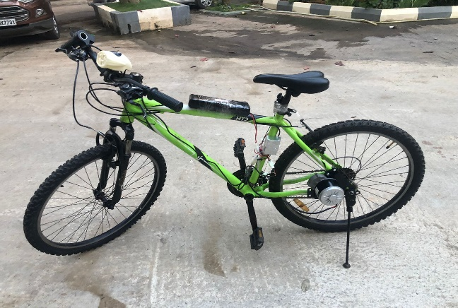
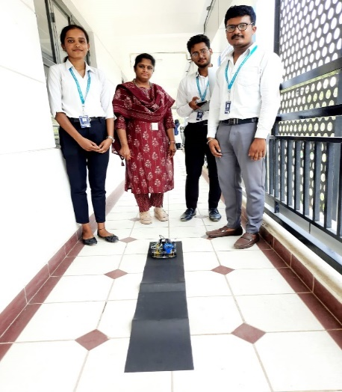
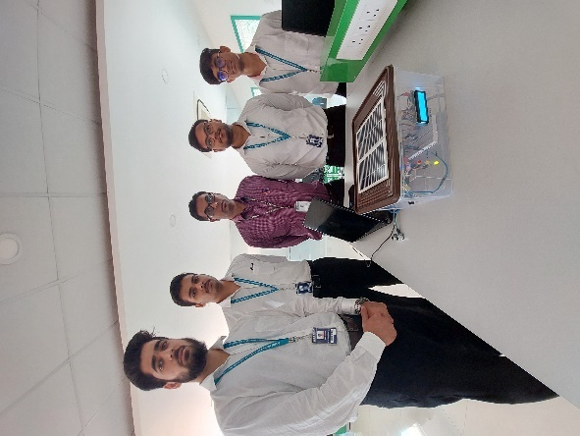
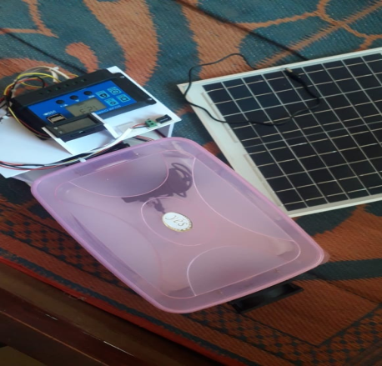
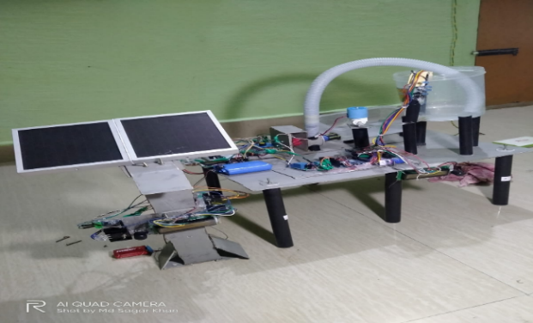
B.E- EEE
PROJECTS
Implementation of Smart E-Vehicle Charging Station powered by Renewable Energy
Implementation of parameter estimation of an electric bicycle using IoT for village / rural/disabled community
Solar Refrigerator for Portable Refrigerator
Optimization of Battery Performance in Electric Vehicle
Solar Driven Vaccine Refrigerator using environment-friendly refrigerants for Off-Grid locations
Artificial Intelligence based SRLF-Driving car using Robotic Model
Design and Implementation of solar fed food alert system using Bolt Wi-Fi Module
Solar based energy efficient hybrid SLBLDC motor for agriculture

Slide 22
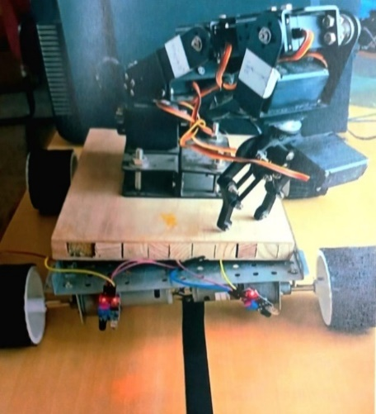
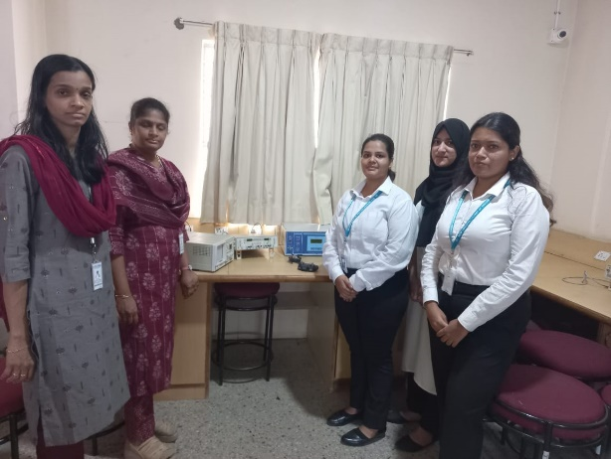
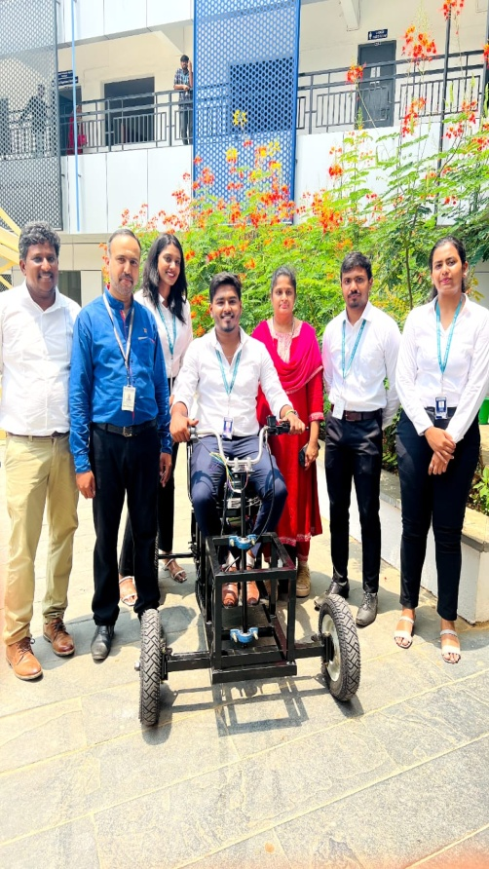
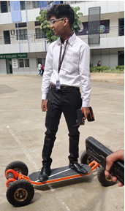
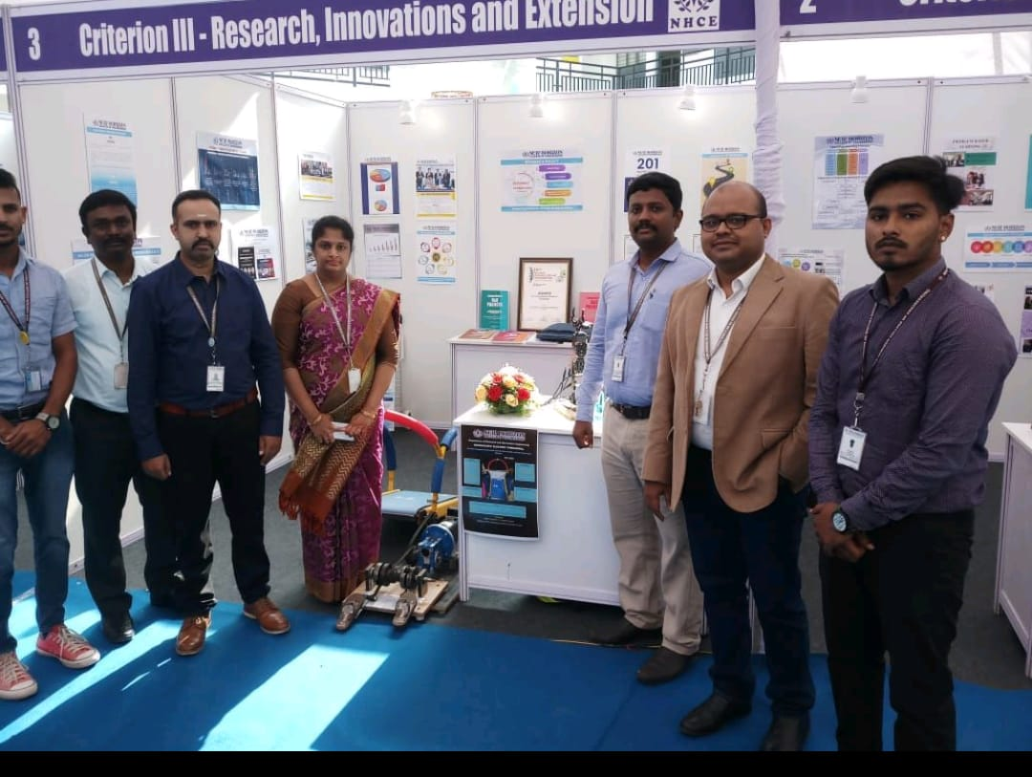
PROJECTS
B.E- EEE
Implementation and design of cobots in floriculture
Silent surveillance autonomous drone for disaster management and military security using artificial intelligence
Design and Fabrication of Quad Bike for Physically Challenged
Therapeutic treadmill
Electrical mountain Board

Slide 23
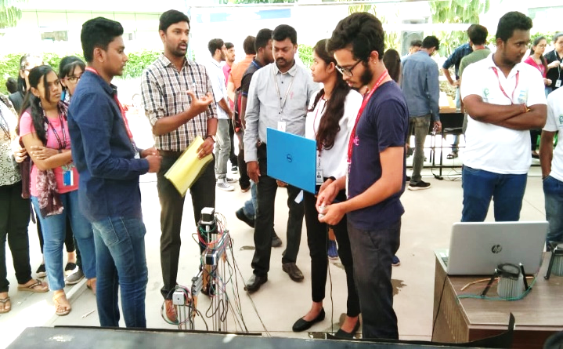
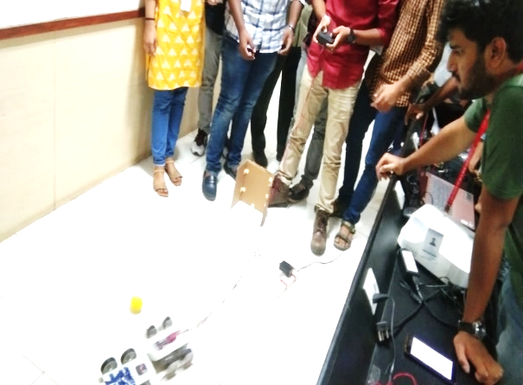
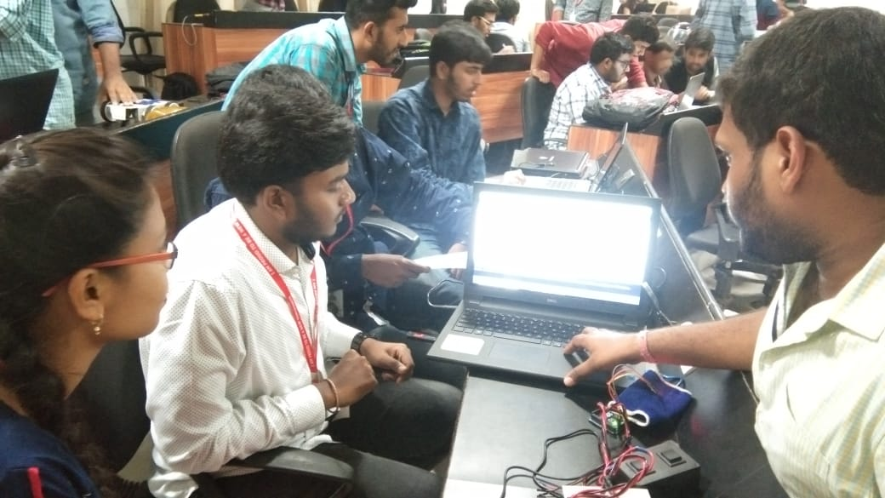
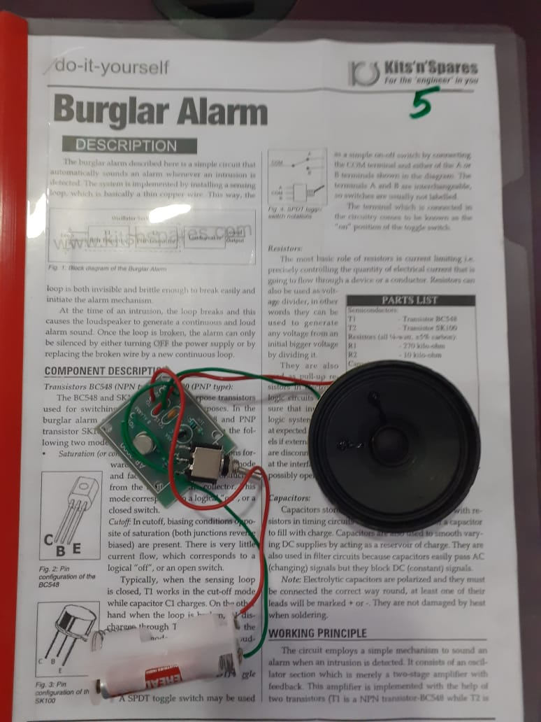
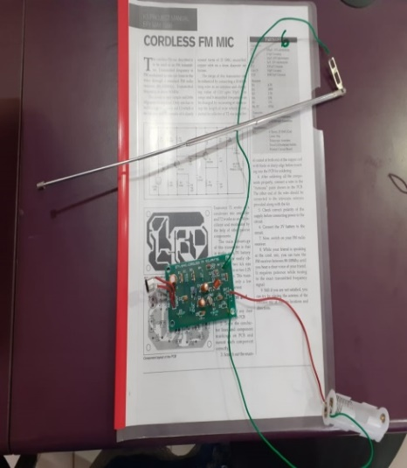
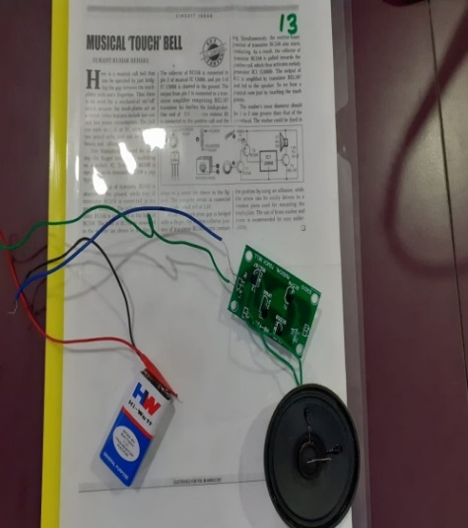
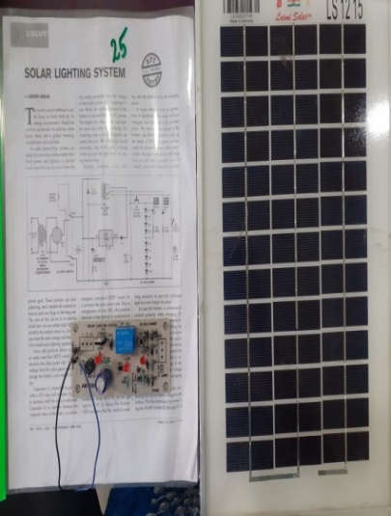
PROJECT BASED LEARNING
B.E- EEE
Working models /charts /monograms

Slide 24
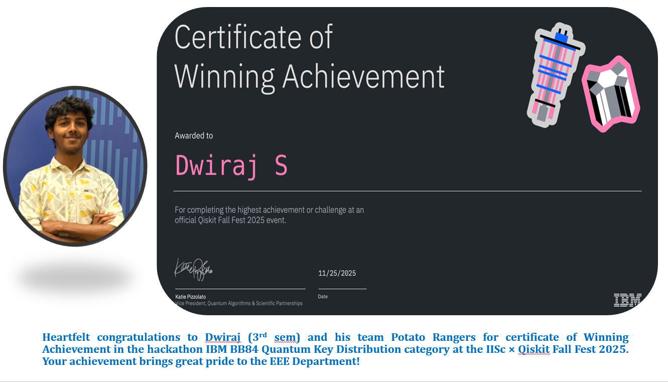
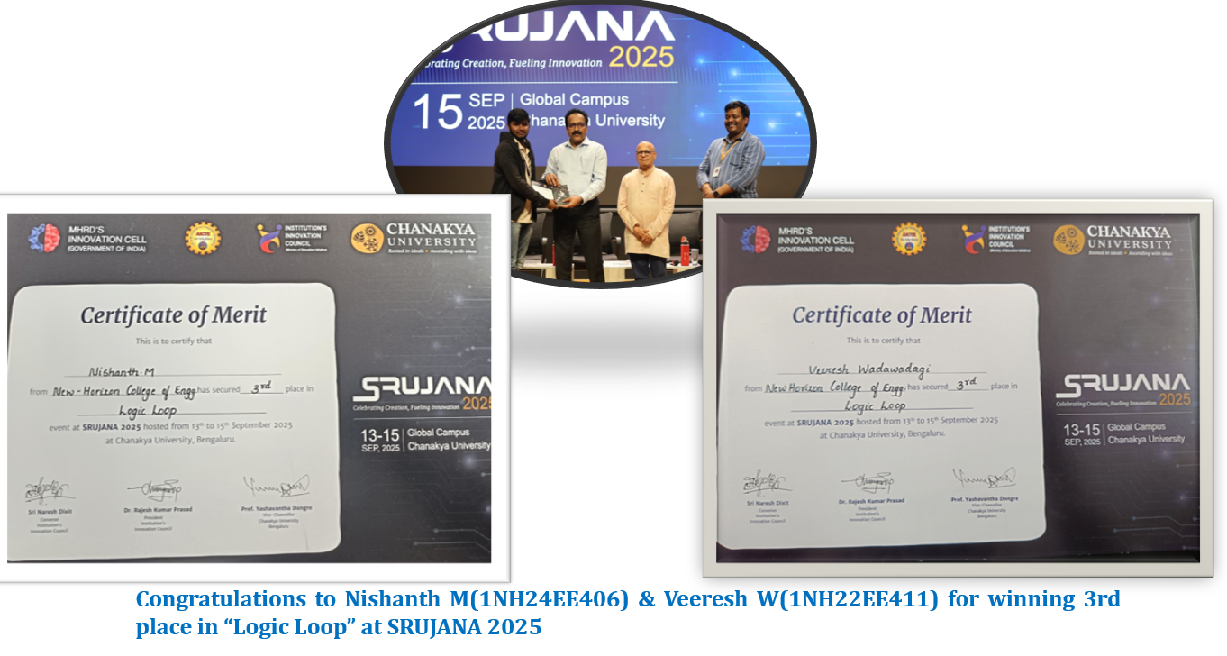
B.E- EEE
STUDENT ACHIEVEMENTS

Slide 25
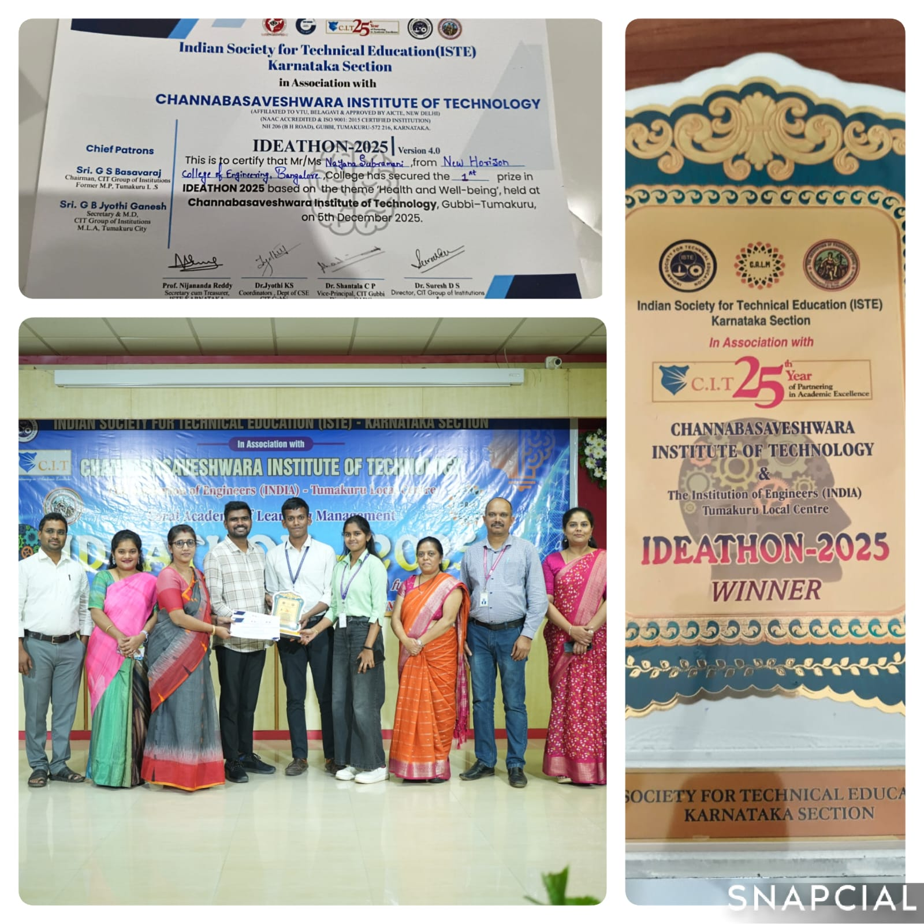
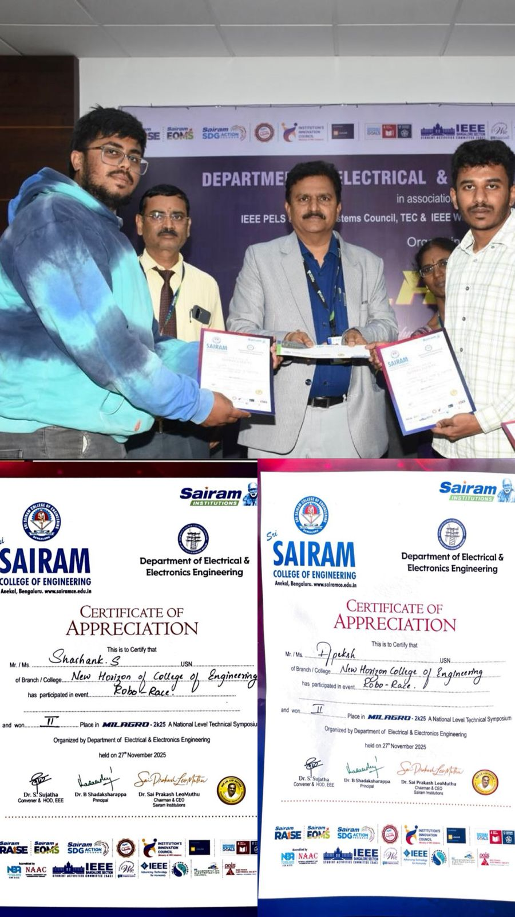
B.E- EEE
STUDENT ACHIEVEMENTS
Nayana Subramani (USN: 1NH24EE064), Secured First prize in IDEATHON, 2025 version 4.0 for the theme health and wellbeing organized by ISTE at Channabasaveshwara Institute of Technology, Tumkur on 5th December, 2025
Apeksh Singh (1NH23EE007) and Shashank S (1NH23EE095) from the Department of Electrical and Electronics Engineering, NHCE participated and Secured Second Prize in Milagro 2K25 (Robo Race) — a National Level Tech Symposium held at Sai Ram College of Engineering.

Slide 26
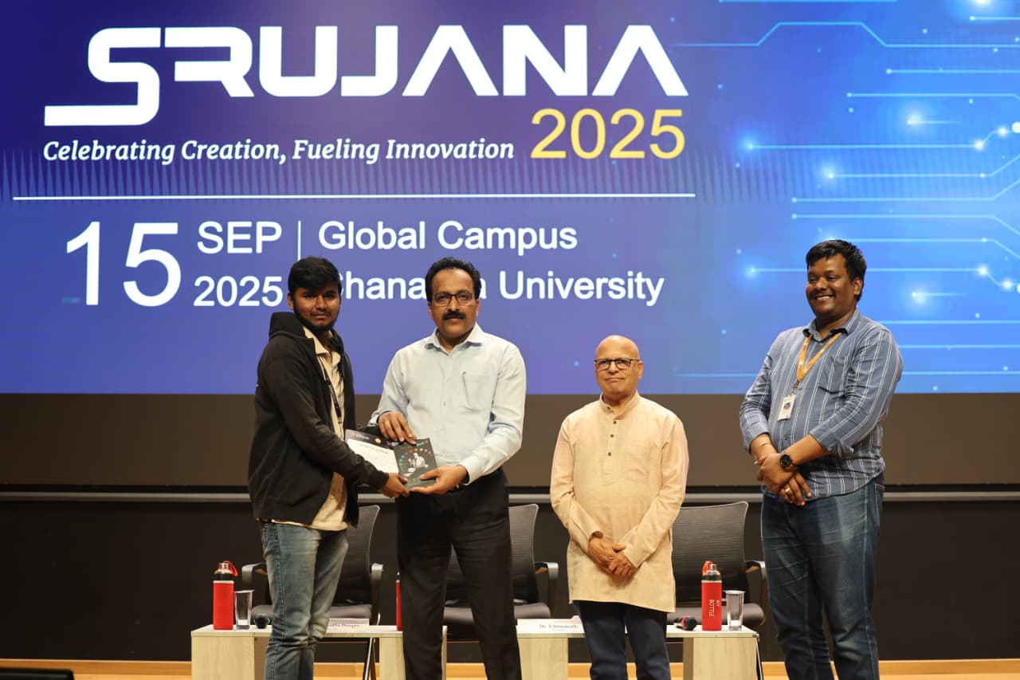
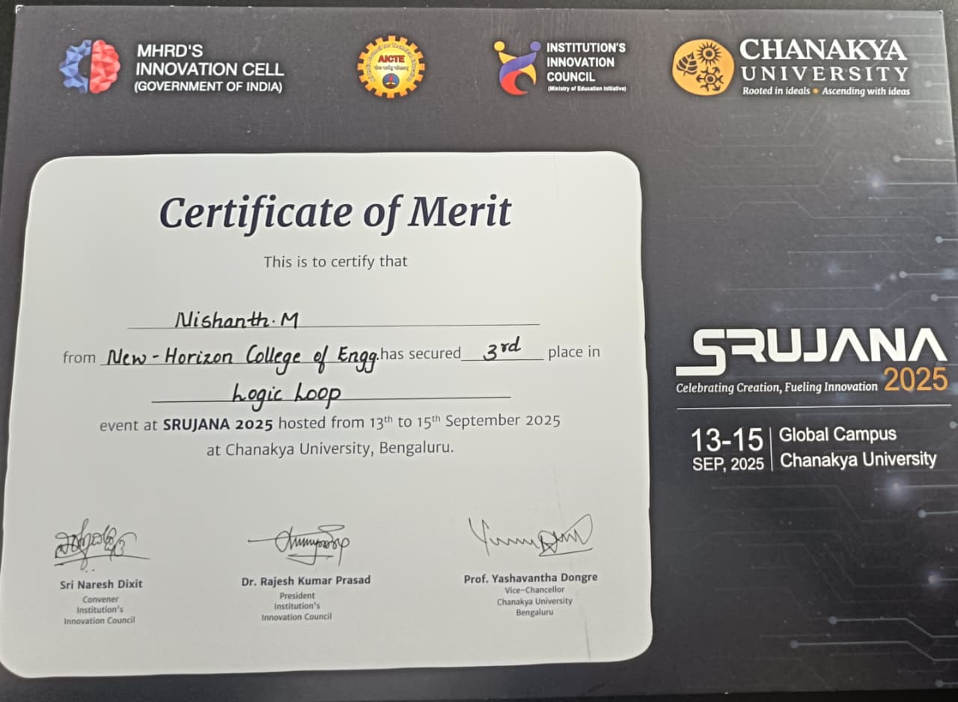
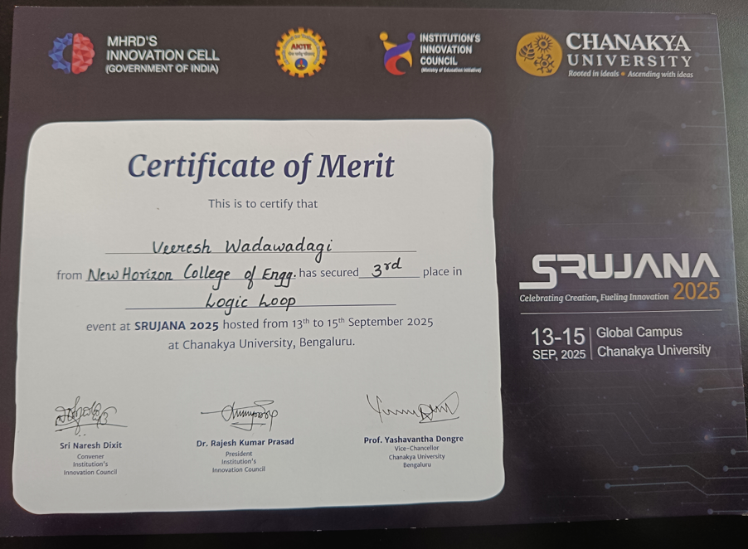
STUDENT ACHIEVEMENTS
B.E- EEE
Nishanth M(1NH24EE406) & Veeresh W(1NH22EE411) for winning Third place in “Logic Loop” at SRUJANA 2025 at Global Campus Chanakya University

Slide 27
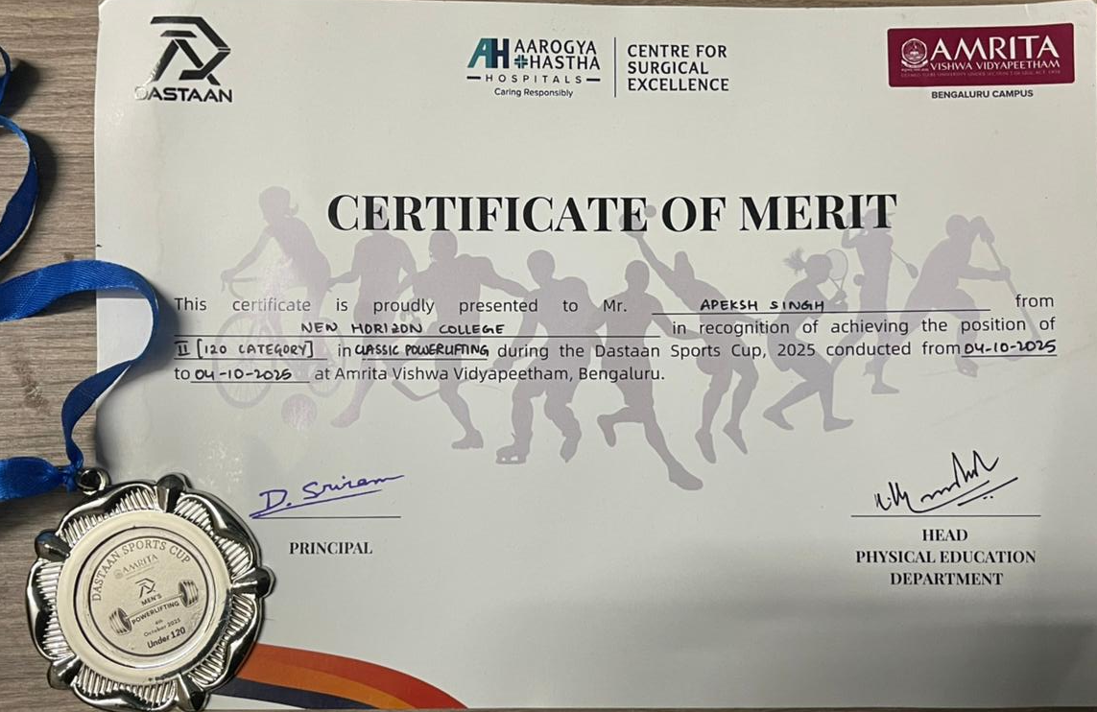
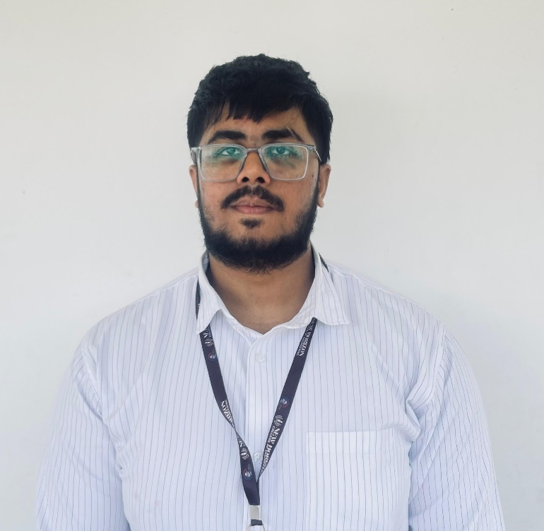
B.E- EEE
STUDENT ACHIEVEMENTS
Congratulations to Apeksh Singh(1NH22EE007) for secured Second Prize in Classic Powerlifting competition(120 Category) at Amrita Vishwa Vidhyapeetham, Bengaluru

Slide 28
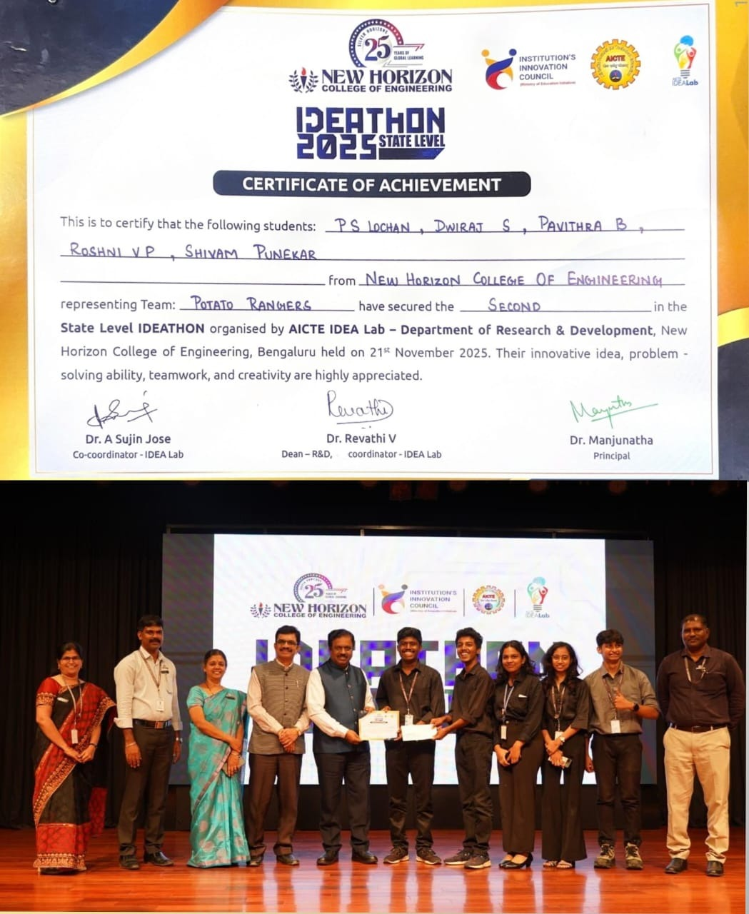
STUDENT ACHIEVEMENTS
B.E- EEE
Dwiraj S – 3rd Sem EEE secured the Second Place at the State Level IDEATHON 2025 Organized by the AICTE IDEA Lab – Department of Research & Development, NHCE

Slide 29
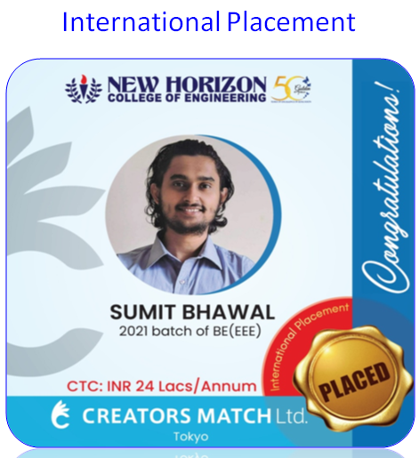


PLACEMENT & TRAINING
B.E- EEE
Aptitude & Soft Skills Training
Employability Index Mapping Workshop
Mock Interviews
CV Writing Workshop
Comprehensive Technical Training
EEE PLACEMENT- Batch 2025
Students Strength | Placed | Startups/ Entrepreneur/ Higher studies
100 | 86 (ongoing) | 5
Placement Percentage | 91%
International Placements

Slide 30



EEE PLACEMENT- 2025

Slide 31

EEE PLACEMENT- 2025

Slide 32




EEE PLACEMENT- 2025
B.E- EEE

Slide 33



EEE PLACEMENT- 2025

Slide 34



B.E- EEE
EEE PLACEMENT- 2025

Slide 35
CO- CURRICULAR ACTIVITIES
B.E- EEE
Training on Endless Automation
International Educational Tour
Hands on Workshop in Simulation Environment
online – AICTE -STTP on THE ROLE OF IOT IN RENEWABLE ENERGY SOURCES DRIVING ELECTRICAL POWER GRIDS
Expert Lecture On “Electric Traction Systems & Employment Opportunities In Indian Railways
International Webinar on “Low Earth Orbit Satellites”

Slide 36


CO- CURRICULAR ACTIVITIES
B.E- EEE
Industrial Visit @ Kaiga Atomic Power Station

Slide 37
CO- CURRICULAR ACTIVITIES
B.E- EEE
Industrial Visit - Karnataka Hybrid Micro Devices Limited (KHMDL), Bengaluru
Industrial Visit to BEML – Exploring Metro Rail Manufacturing
ISRO URSC Visit
Industrial Visit-Dynaelectric Equipment Ltd

Slide 38
CO- CURRICULAR ACTIVITIES
B.E- EEE
Industrial Visit-Zeonics Systech Defence & Aerospace Engineers Pvt. Ltd
Industrial Visit to Karnataka Hybrid Micro Devices Limited (KHMDL)

Slide 39
EXTENSION ACTIVITIES
B.E- EEE
Green Conservation Campaign
Green Fest @ NHCE
Cleanliness Drive @ Jakkur Lake
Visit – orphanage

Slide 40
EXTENSION ACTIVITIES
B.E- EEE
Guest Talk on Energy Audit Made easy
Green week
Social and Green Outreach @ Marthahalli Govt School
Energy conservation campaign at Government school, Marathahalli
Awareness program @ Jakkur lake

Slide 41






PARENT TEACHER INTERACTION
B.E- EEE
KEY HIGHLIGHTS
Individual student performance discussion
Academic progress & attendance monitoring
Career guidance and skill roadmap
Early identification of learning gaps
Strong parent–faculty connect
Our Commitment: Every student is known, guided, and supported.

Slide 42



THANK YOU
For more information please contact
Phone: 080-66297777
E mail: admissionsnhce@newhorizonindia.edu
Website: B.Tech Electrical Engineering | Career, Eligibility, Admission and Fees
Follow us on:

